Slide 1

THE NETFLIX PRIZE
Project by: Davide Guidobene 877150
Course: Social Network Analysis
Professor: Zollo Fabiana

Slide 2
The Netflix Prize
The Netflix Prize was an open competition for the best collaborative filtering algorithm to predict user satisfaction per movie.
The competition was held by Netflix in order to improve their recommender system, starting from October 2, 2006 and, on September 21, 2009, the Grand Prize of $1,000,000 was awarded to BellKor’s Pragmatic Chaos team.
In the following presentation we will see a different approach to find similarities among group of movies and users based on graphs clustering, using data published for the competition.

Slide 3
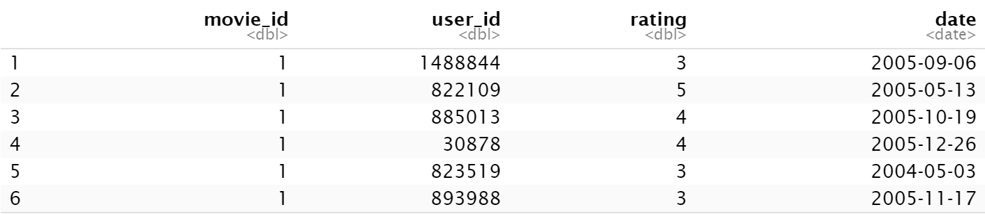
Netflix provided the training data set of ratings in the form of a .txt file where each rating is in the form of a quadruplet: <movie_id, user_id, rating, date>.
Using R we were able to read the data and elaborate it in the from of a dataframe where each row represents a rating.
Data Preparation

Slide 4
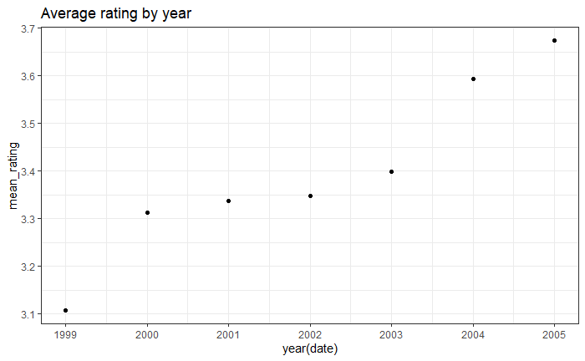
Effects of time
From 2004 we can notice a significant improvement in the average rating of the audience.
Reason: rating changed from an objective scale (excellent, good, fair, …) to a subjective scale (loved it, liked it, …).
Data before 2004 is outdated.

Slide 5
Data elaboration
and visualization
01.
02.
Bipartite graph
Five subgraphs
Building a bipartite graph from the data. Users and movies are represented by nodes and ratings by weighted edges
Splitting the bipartite graph in 5 subgraph induced each by a different rating star (or edge weight): 1, 2, 3, 4, 5.
03.
04.
Users projection
Movies projection
Making a bipartite projection on users for each subgraph.
Afterwards we unite the 5 projections in one graph and divide it in clusters.
Making a bipartite projection on movies for each subgraph.
Afterwards we unite the 5 projections in one graph and divide it in clusters.

Slide 6
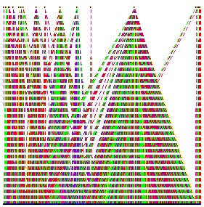
01.
Bipartite graph
Legend vertex:
blue: user
orange: movie
Legend edge (rating):
yellow: 1
pink: 2
red: 3
green: 4
violet: 5

Slide 7
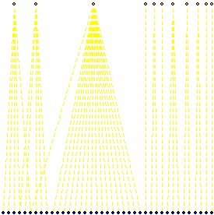
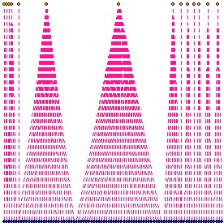
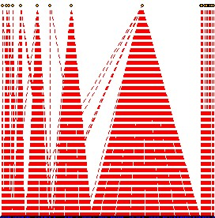
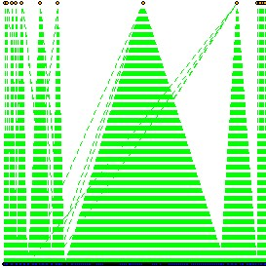
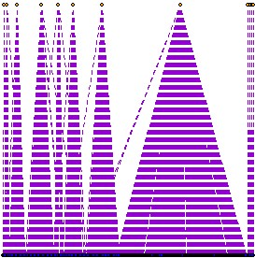
02.
Five subgraphs

Slide 8
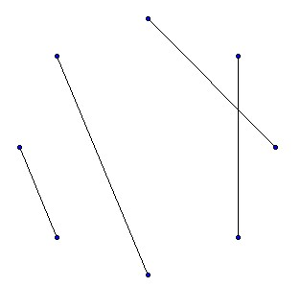
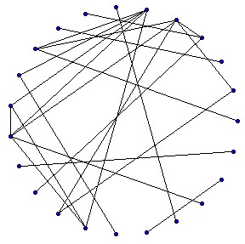
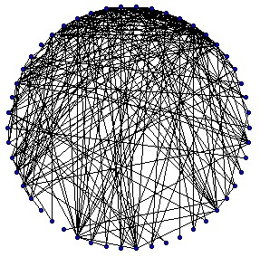
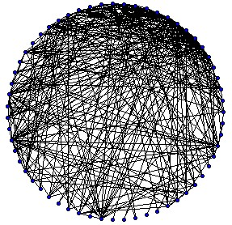
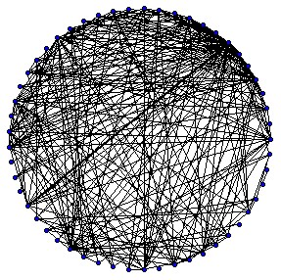
Bipartite projection on user nodes of each subgraph
03.
Bipartite projection
(users)

Slide 9
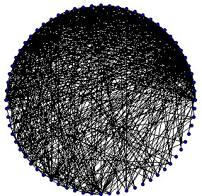
Union of all the users bipartite projections. In this graph 2 users are connected with an edge of weight equal to the number of movies they reviewed with the same star rating.
03.
Bipartite projection
(users)

Slide 10
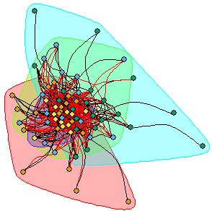
We partition our resulting graph in clusters.
Users with similar tastes in movies will likely end up in the same cluster.
03.
Bipartite projection
(users)

Slide 11
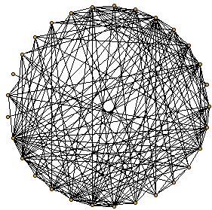
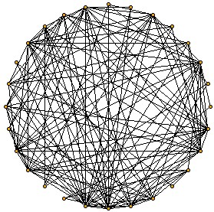
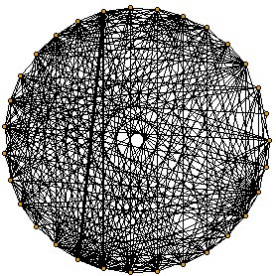
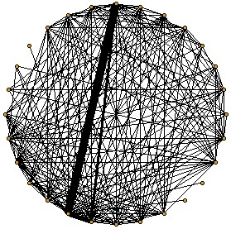
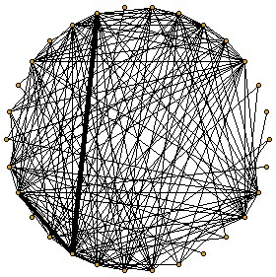
Bipartite projection on movie nodes of each subgraph
04.
Bipartite projection
(movies)

Slide 12
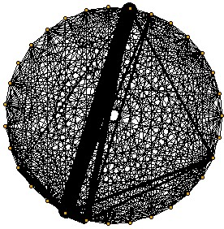
Union of all the users bipartite projections. In this graph 2 movies are connected with an edge of weight equal to the number of users that gave them the same star rating.
04.
Bipartite projection
(movies)

Slide 13
We partition our resulting graph in clusters.
Similar movies will end up in the same cluster.
04.
Bipartite projection
(movies)

Slide 14


Comparison of
bipartite projections
Projection on users
Projection on movies
To recommend a movie to a certain user U, we pick the movies that received the highest rating by the most similar users to U.
To recommend a movie to a user U, we pick the most similar movies to U’s highest rated movies.
Efficiency: since in the starting bipartite graph we have 425294 users and 4498 movies, it’s much more efficient to calculate the bipartite projection on movies.

Slide 15
Data elaboration
and visualization
05.
06.
Retrieving genres
Homophily
Using Cinemagoer API for IMdb in order to retrieve the genre of the movies
Studying homophily on movies network based on years of release and genres
07.
08.

Slide 16

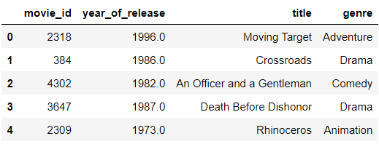
05.
Using Cinemagoer API for IMdb I used movies title and year of release in order to pivot the genre of the movies
Retrieving genres

Slide 17
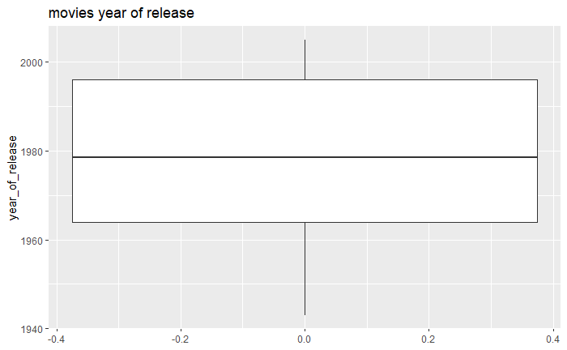
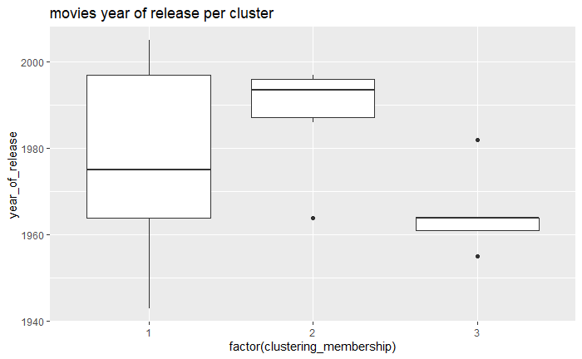
06.
Testing if there is homophily among movies released in close year gaps or among movies of the same genre.
Homophily

Slide 18
Thanks !

Slide 19
Presentation template by
http://pptmon.com/ Click to follow link

Slide 20
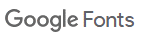
Poppins Font download by
https://fonts.google.com/specimen/Poppins Click to follow link

Slide 21

Data download from
https://www.kaggle.com/netflix-inc/netflix-prize-data
https://www.netflixprize.com/

Slide 22
Data download from
https://developer.imdb.com/

